Slide 1
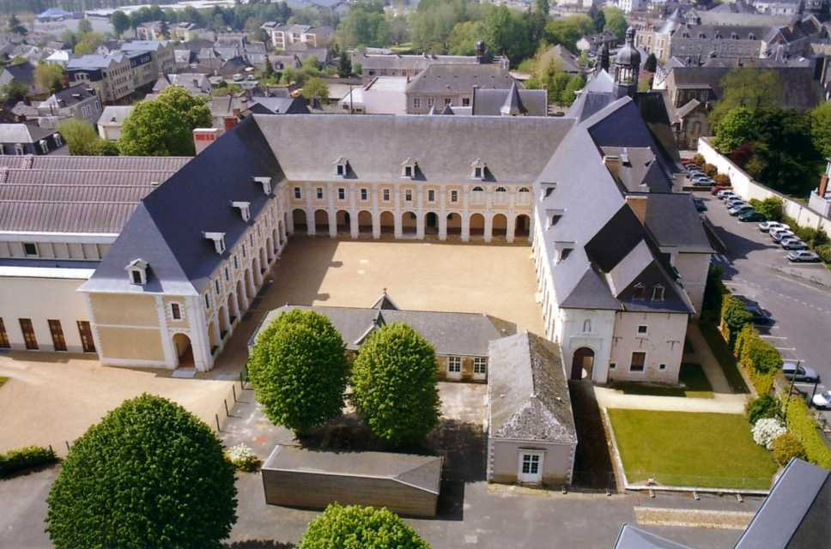
Château-Gontier

Slide 2
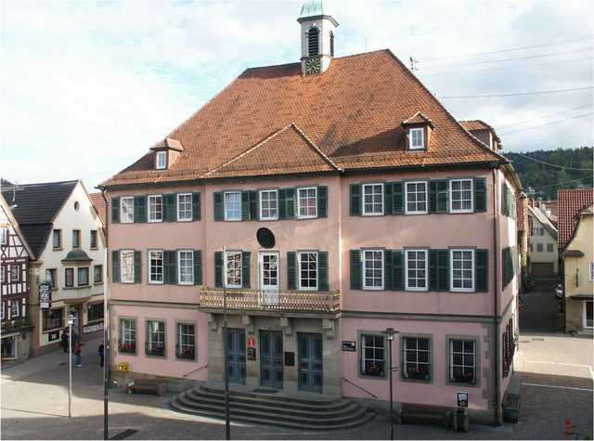
Murrhardt

Slide 3
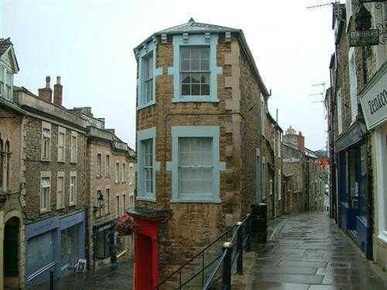
FROME

Slide 4
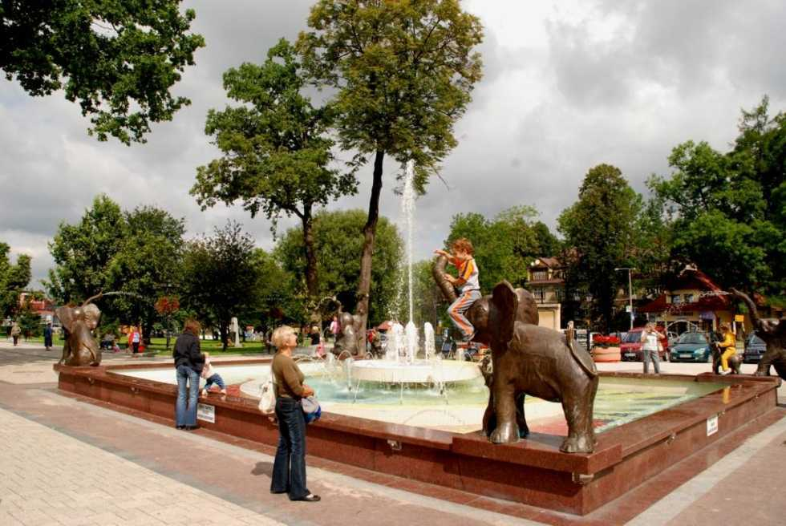
Rabka-Zdrój

Slide 5
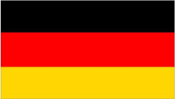
1964
2009
45 years of twinning

Slide 6
1964
2009
Château-Gontier

Slide 7
1964
2009
Murrhardt

Slide 8
1964
2009
Frome

Slide 9
1964
2009
What have we achieved?

Slide 10
The Franco-German twinnings
The movement of the Franco-German twinning was born after the Second World War, when in 1950 the mayor of Montbéliard Tharradin Lucien, former tough and a survivor of Buchenwald, laying the foundations of a pairing with Ludwigsburg in Baden - Württemberg.
This match will be formalized in 1962, a year before the signing by Charles de Gaulle and Konrad Adenauer of the Franco-German reconciliation. This twinning has been symbolic.
Twinnings Franco-German will have in their development from the 60s until the late 80.
In 2007 there were approximately 2 200 Franco-German twinning of cities and regions.

Slide 11
What have we achieved together?
Château-Gontier
Murrhardt
Frome

Slide 12
What have we achieved together?
1964
In 1964, Mr. Louis Fourmond, deputy of Mayenne, plans to launch a twinning between Chateau-Gontier and a German city.
He mentioned this idea to Dr. Lefèvre, mayor of Château-Gontier, who was not opposed to the project.

Slide 13
What have we achieved together?
1964
The German embassy in Paris told him the cities of the same importance as Chateau-Gontier, who also want to contact french cities.
Three German cities, including Murrhardt are selected

Slide 14
What have we achieved together?
1964
A woman of Chateau-Gontier, Madame Sizaret, who had formerly resided in the Swabian Jura - near the forest Swabia - who had kept a good souvenir, tipped the balance Murrhardt side.

Slide 15
What have we achieved together?
November 1965
Château-Gontier & Murrhardt
A delegation from Château-Gontier led by the Mayor and some town councillors visited Murrhardt
They were warmly received and from 1966 trips and school exchanges have occurred

Slide 16
What have we achieved together?
September 24th 1966 in Château-Gontier
The two Mayors at the time, Dr.Georges Lefèvre and Herr Helmut Götz, signed the twinning agreement between the two towns.

Slide 17
What have we achieved together?
September 9th 1977 in Murrhhardt
The twinning ceremony was solemnly held at the City Hall Murrhardt, in the presence of a very large crowd.

Slide 18
What have we achieved together?
June 7th 1975 in Château-Gontier
A delegation from Frome came to Château-Gontier led by Peter Bardgett, Mayor and Chairman of the Twinning Association
The square saying " Square de Frome " was inaugurated alongside the Quai d'Alsace.

Slide 19
What have we achieved together?
September 1975 in Frome
The twinning is formally sealed. The group from Château-Gontier is headed by the Mayor and District President , Jean Arthuis.

Slide 20
What have we achieved together?
1983 : Twinning between Murrhardt and Frome
In September 1979, Chateau-Gontier suggested that Frome establish a partnership with Murrhardt
In November 1982, Frome gave its approval for the Twinning and the first charter was signed on 24 September 1983 in Frome by Mayor Bob Gooding and for Murrhardt by Mayor Helmut Götz.

Slide 21
What have we achieved together?
Tripartite : september 21st 1985 in Frome
The three towns, Château-Gontier, Murrhardt & Frome agreed a tripartite link
The official signing of this multilateral agreement was done by the Mayors, Jean Arthuis, Peter Belham and Helmut Götz

Slide 22
What have we achieved together?
Exchanges
Schools
Sports
Cultural associations
Economics
Individuals

Slide 23
What have we achieved together?
The objective has been before all, to establish sustainable links between the populations of the three twinned cities.
Thanks to exchanges between associations, many citizens of Château-Gontier, Murrhardt and Frome have established friendly private relations.

Slide 24
What have we achieved together?
We must recognize that the exchanges have today need a new dynamic.
The arrival of Rabka- Zdrój will allow a new impetus necessary for the development of our twinning and the creation of new links between our four European cities.

Slide 25
What have we achieved together?
Image gallery

Slide 26
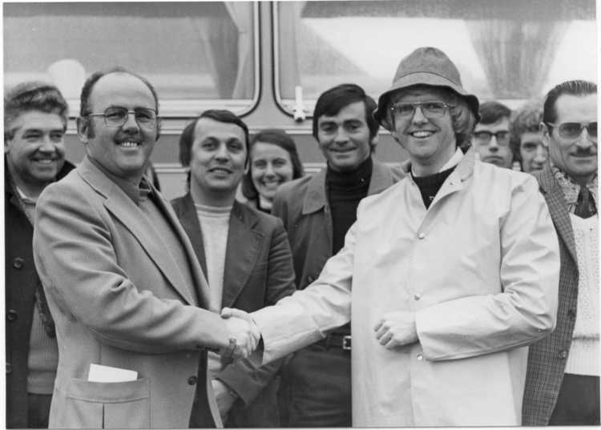
First exchanges between
Château-Gontier and Frome
Peter BARDGETT, founding member
of twinning in Frome

Slide 27
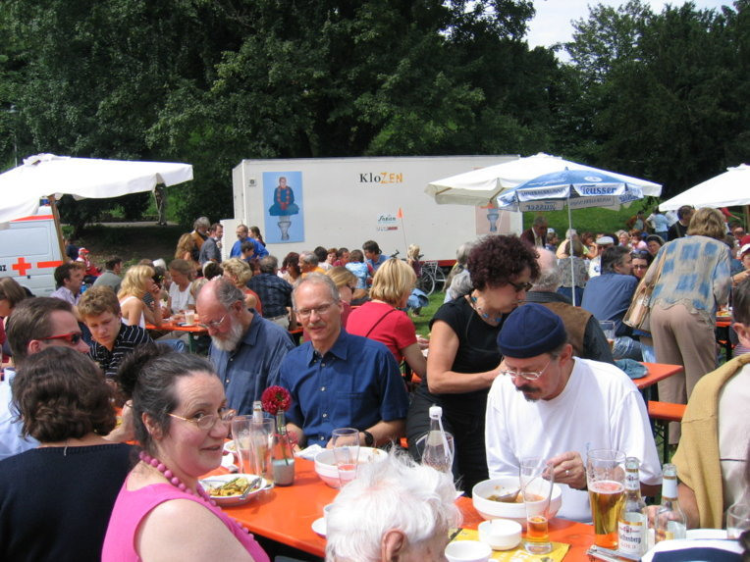
Tripartite 2005 - Murrhardt
Sommer Palast

Slide 28
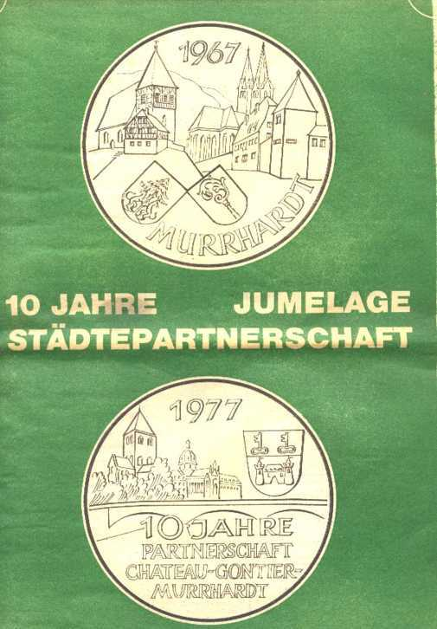
1977

Slide 29
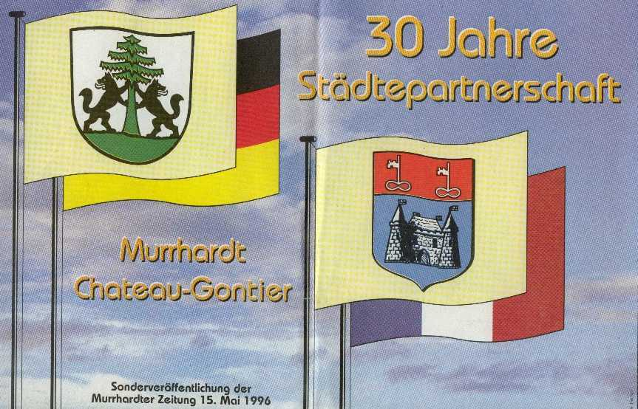
Peter BARDGETT, founding member
of twinning in Frome
1996

Slide 30
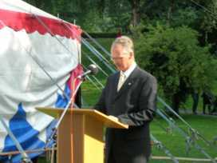
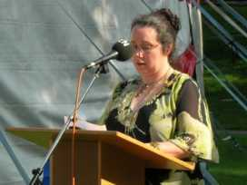
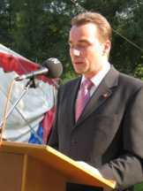
Tripartite 2005 - Murrhardt
Gerhard Strobel,
mayor of Murrhardt
Karen Harvey,
mayor of
Frome
Philippe Henry,
mayor of
Château-Gontier

Slide 31
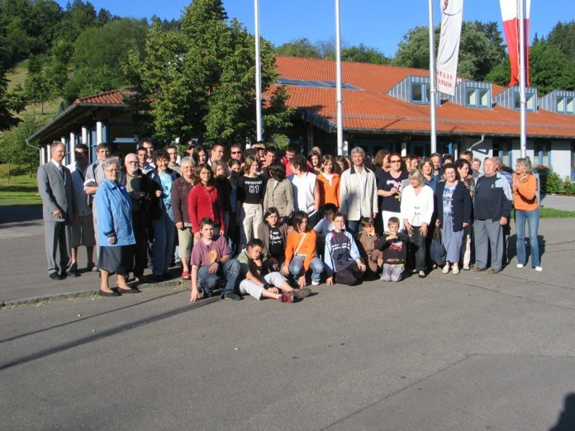
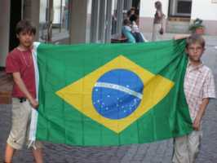
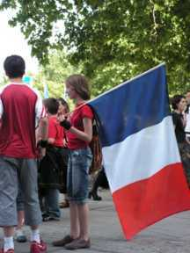
World Cup 2006 - Murrhardt
50 persons from Chateau-Gontier

Slide 32
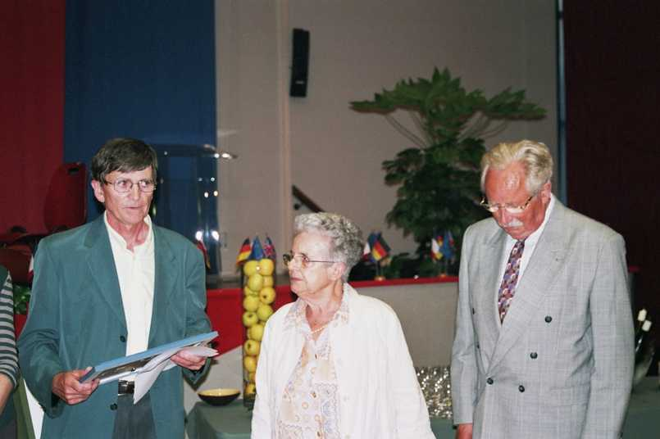
Château-Gontier 2006
Souvenir to Mrs. Sizaret, a founding member of the twinning
between Château-Gontier and Murrhardt

Slide 33
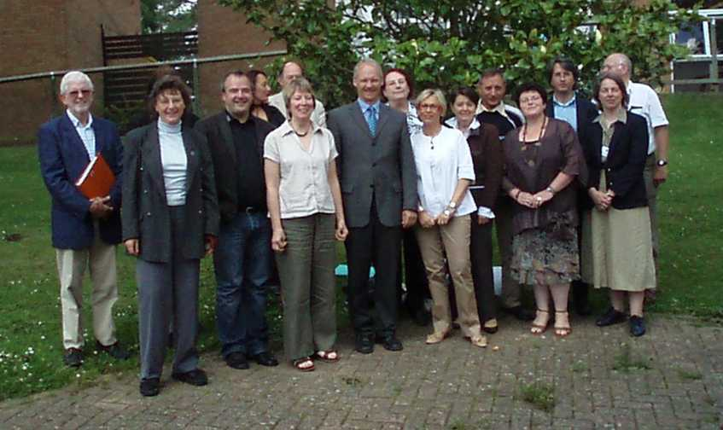
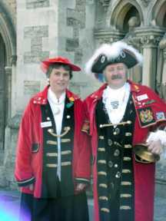
Frome 2007
After the meeting

Slide 34
Organisation
Château-Gontier
Since the beginning, the twinning is organized by an association in connection with the town of Chateau-Gontier (today : Château-Gontier, Azé and St-Fort).
The Twinning Committee is headed by a team of 20 persons :
3 representatives of cities and 17 individuals.
The Twinning Committee is in relation with the population in order to develop relations with twin cities.
It is responsible for relations with the twin cities.

Slide 35
Organisation
Château-Gontier
We believe that the development of twinning is possible only if the latter is managed by the citizens themselves.
The Committee's role is to meet the citizens, in order to :
Create new exchanges with the twin cities,
- Support of exchanges already existing.

Slide 36
Organisation
Château-Gontier
Other roles of the Committee :
Manage school exchanges
(about 15 travels or exchanges each year)
Organize lessons in foreign languages for adults (65 persons)
(English - German - Spanish - Arabic)

Slide 37
July 2009
A new partner ...

Slide 38
July 2009
Rabka-Zdrój

Slide 39
July 17st 2009 in Rabka-Zdrój
The four towns, Château-Gontier, Murrhardt, Frome and Rabka-Zdrój have signed a quadripartite twinning.
The official signing of this multilateral agreement have been done by the Mayors, Ewa Przybyło, Philippe Henry,
Damon Hooton, Gerhard Strobel.

Slide 40
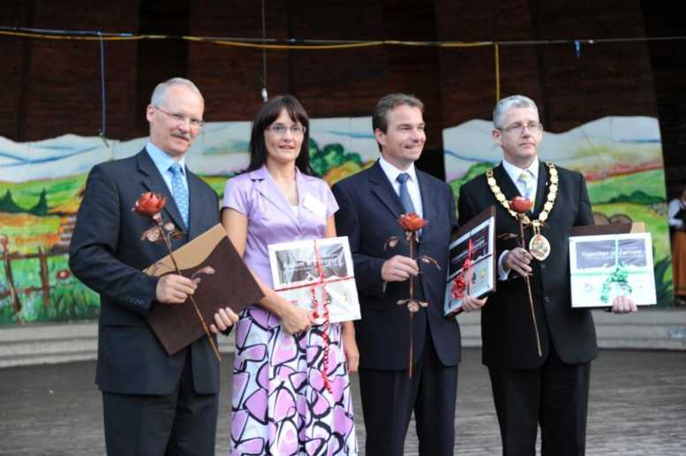
The four Mayors

Slide 41
F I N
E N D
E N D E
K O N I E C

